Slide 1

MANAGEMENT OF NATURAL RESOURCES
Coal and petroleum
Overview of natural resource management

Slide 2


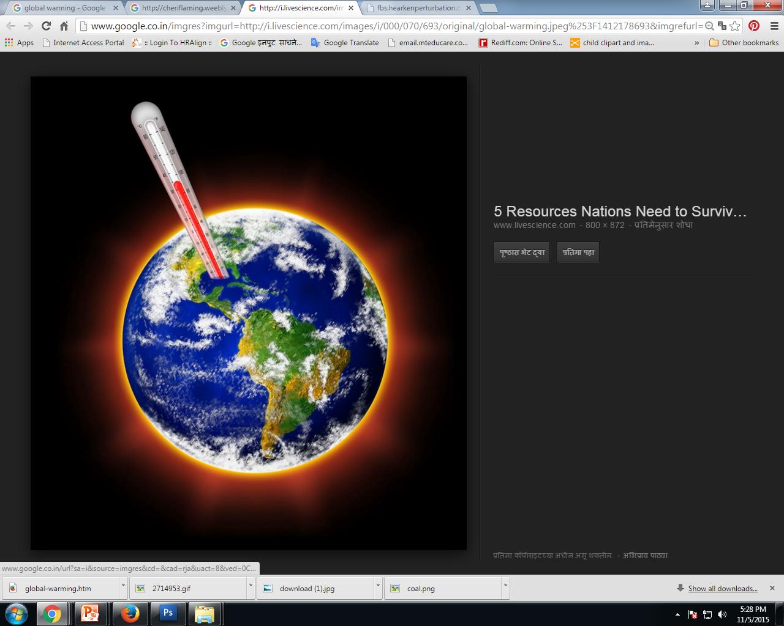


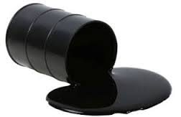
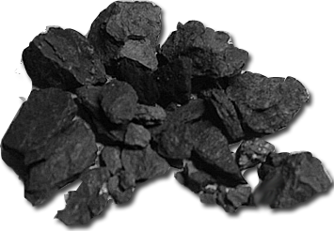
C
C
C
If all of this carbon is converted to carbon dioxide.
o
o
o
o
o
o
C
C
o
o
o
o
Another way of looking at coal and petroleum is ………
Then the amount of carbon dioxide in the atmosphere is going to increase leading to intense global warming.
C
Huge reservoirs of carbon

Slide 3


Thus, we need to use these resources judiciously.

Slide 4


Some simple choices can make a difference in our energy consumption patterns.
Now let us see some examples of simple choices ….

Slide 5




Taking a bus, over using your personal vehicle or walking/cycling.

Slide 6


Using bulbs or fluorescent tubes in your homes.

Slide 7


Using the lift or taking the stairs.

Slide 8


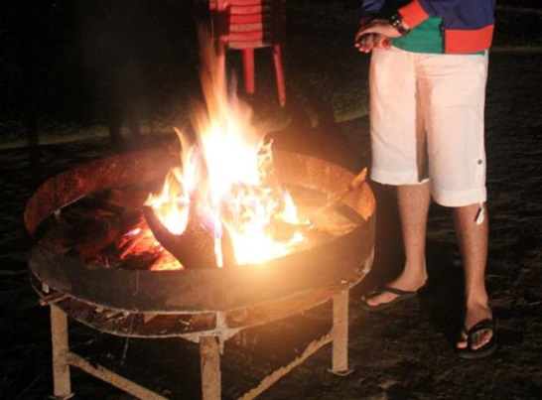
Wearing an extra sweater or using a heating device (heater or ‘sigri’) on cold days.

Slide 9
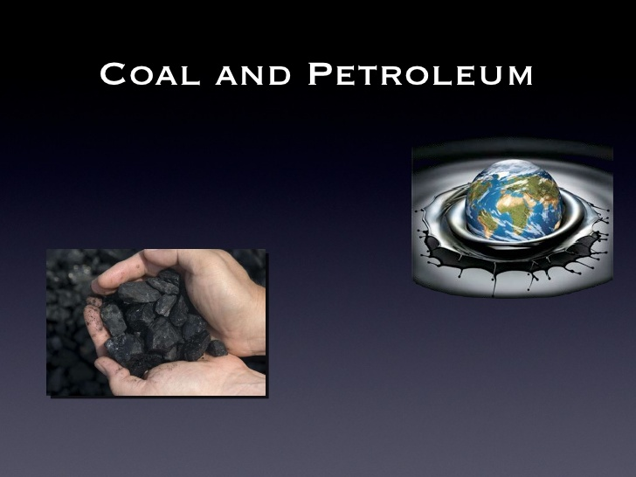

The management of coal and petroleum also addresses the efficiency of our machines.

Slide 10
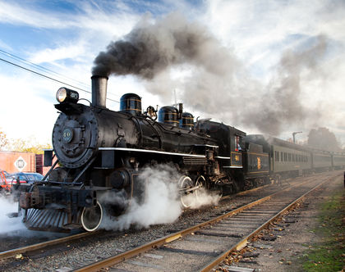
Fuel is most commonly used in internal combustion engines for transportation.

Slide 11
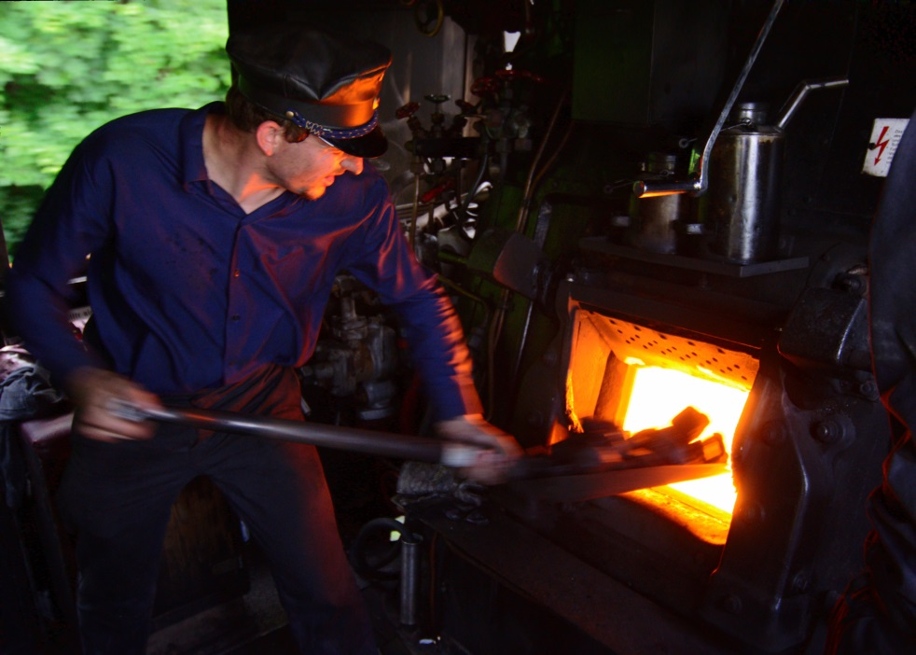

Recent research in this field concentrates on ensuring complete combustion in these engines in order to increase efficiency and also reduce air pollution.

Slide 12


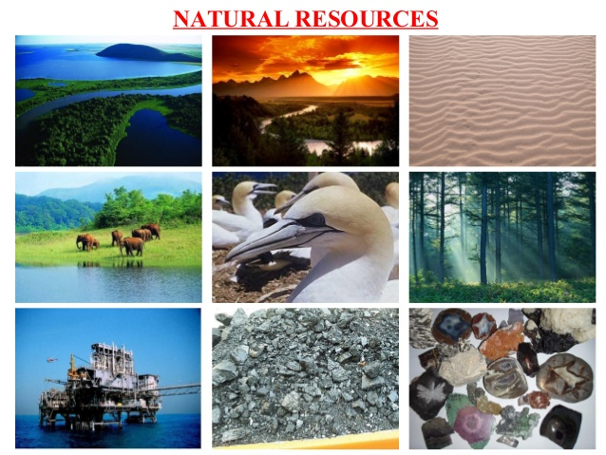
AN OVERVIEW OF NATURAL RESOURCE MANAGEMENT
Sustainable management of natural resources is a difficult task.

Slide 13
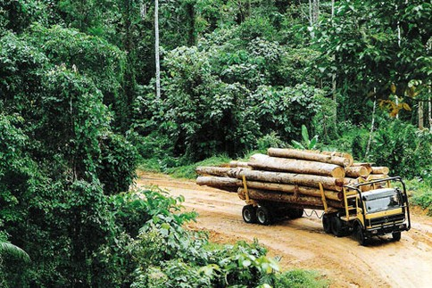
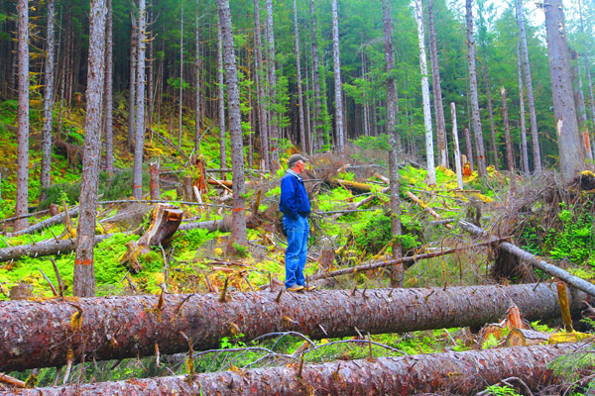
AN OVERVIEW OF NATURAL RESOURCE MANAGEMENT
In addressing this issue, we need to keep an open mind with regard to the interests of various stakeholders.

Slide 14
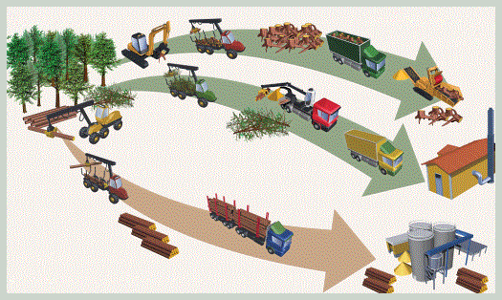
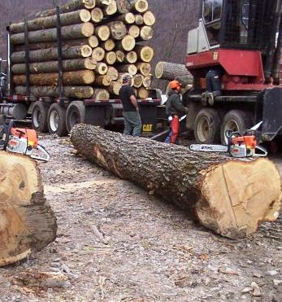

AN OVERVIEW OF NATURAL RESOURCE MANAGEMENT
We need to accept that people will act with their own best interests as the priority.

Slide 15

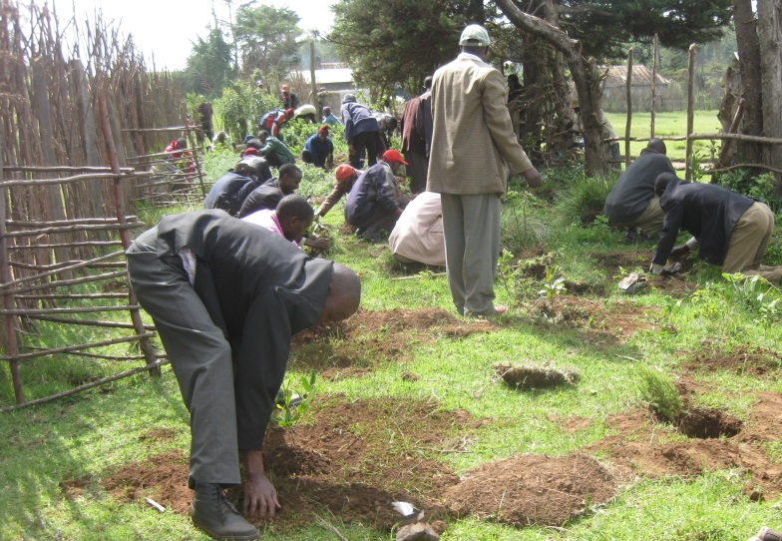
AN OVERVIEW OF NATURAL RESOURCE MANAGEMENT
But the realization that such selfish goals will lead to misery for a large number of people and a total destruction of our environment is slowly growing.

Slide 16
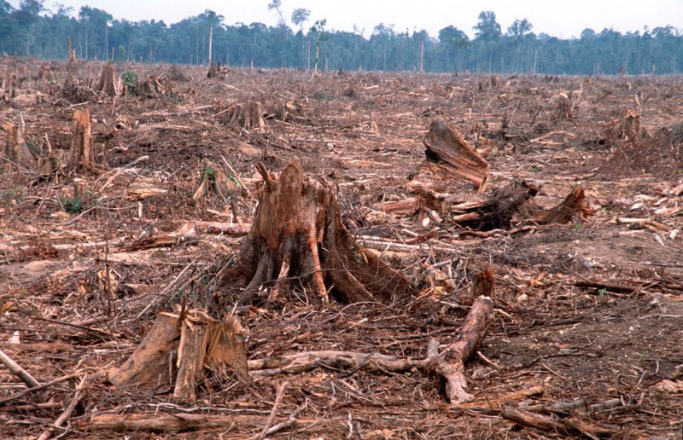
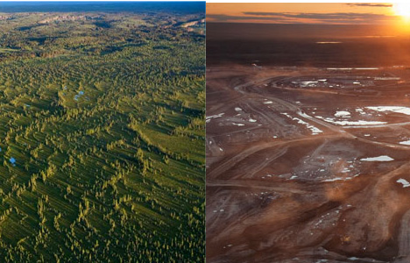
AN OVERVIEW OF NATURAL RESOURCE MANAGEMENT
But the realization that such selfish goals will lead to misery for a large number of people.

Slide 17
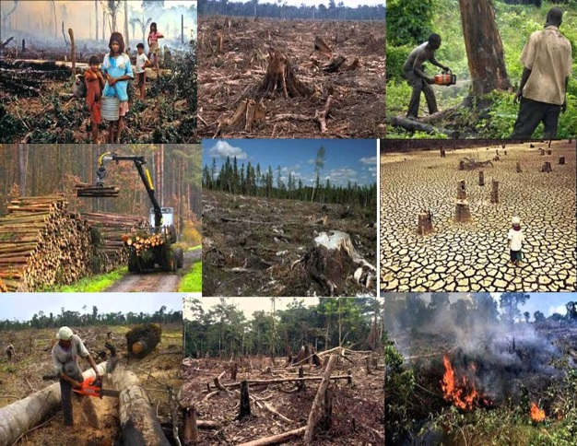

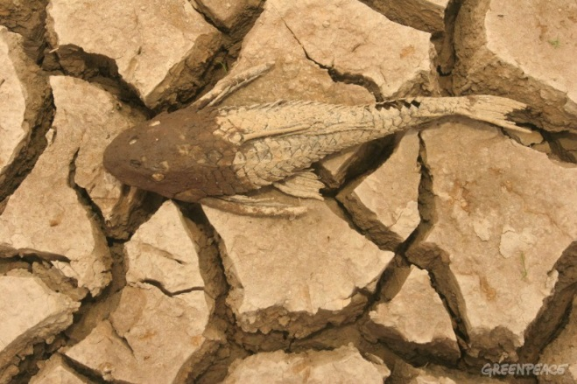
AN OVERVIEW OF NATURAL RESOURCE MANAGEMENT
A total destruction of our environment is slowly growing.

Slide 18








AN OVERVIEW OF NATURAL RESOURCE MANAGEMENT
Going beyond laws, rules and regulations,
we need to tailor our
requirements,
individually and collectively,
so that the benefits of
development reach everyone now and for all generations to come.

Slide 19
Thank You

